Slide 1



A Comparative Analysis of Forecasting
for Supply Chain Optimization
Industrial Engineering Capstone Project | IE 4197
Hakan İspir • Boran Turan • Deniz Yağmur Adaş • Ali Kahya
Supervisor: Prof. Dr. Serol BULKAN

Slide 2
Table of Contents
Problem Definition
Research Objectives
Data Characteristics
Supply Chain Challenges
Methodology
Benchmark Results & Recommendations
Sustainability & ESG
Roadmap to IE4198
Image Sources & References
Questions

Slide 3
Problem Definition
Mitigating the Bullwhip Effect in Modern Retail

Slide 4






Research Objectives
Accuracy Benchmarking
System Scalability
Financial Impact
Implement a "Dual-Track" pipeline using Polars to process 59M rows of Walmart data.
Quantify "Value of Information" through Total Logistics Cost (Holding + Stockout) simulation.
Compare Classical (ARIMA/HW) vs. ML (LightGBM) vs. Deep Learning (LSTM) performance.

Slide 5
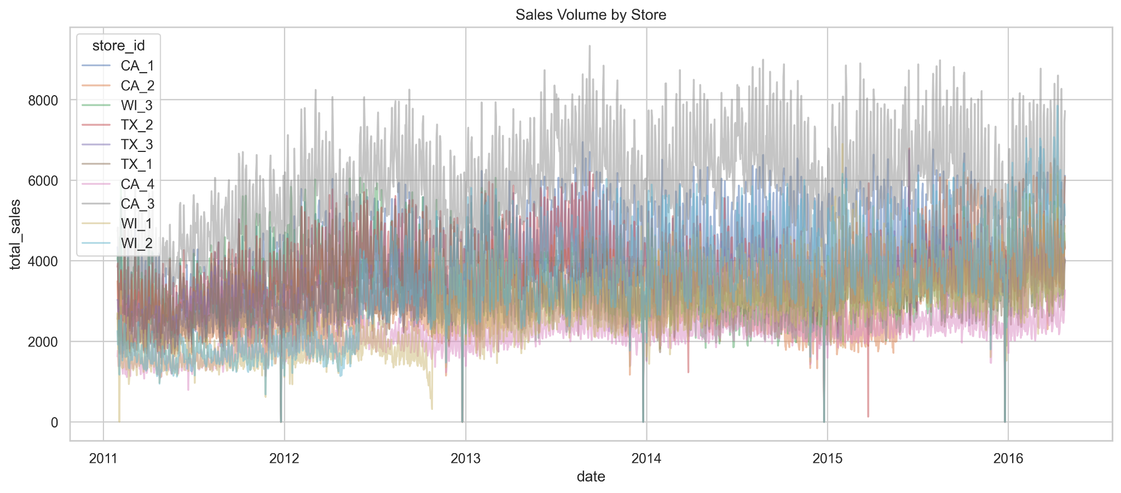
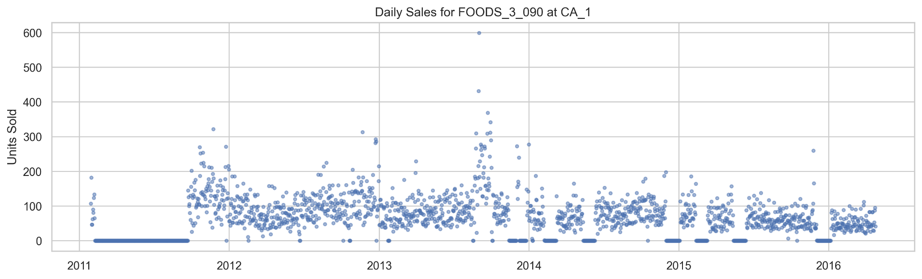
Data Characteristics: M5 Challenge
Scale: 30,490 SKUs across 10 Walmart stores.
Volume: 1,913 days of history; ~58 Million melted rows.
Complexity: High seasonality and hierarchical dependencies.
Intermittency: Massive zero-inflation (sparse sales patterns).

Slide 6
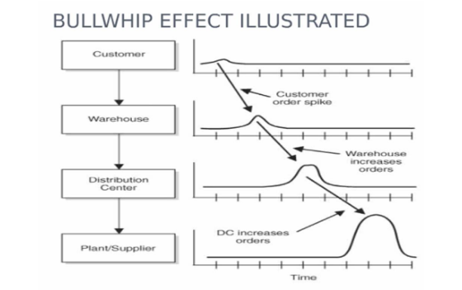
Supply Chain Challenges
Demand Volatility: High product variety (30,490 SKUs) leading to "zero-inflated" or intermittent demand patterns.
The Bullwhip Effect: Small retail demand fluctuations causing amplified variances upstream, leading to waste.
Financial Imbalance: The constant trade-off between excessive holding costs and the risk of costly stockouts.
Modeling Gap: Traditional statistical methods struggle with exogenous variables like price changes and SNAP holidays.

Slide 7


Methodology: The Dual-Track System
Track A: Python Full-Scale
Track B: Classical IE Baseline
Processing the entire hierarchy using high-performance libraries.
Analyzing a stratified sample of SKUs (CA_1 Store Pilot).
•
LightGBM (Gradient Boosting)
•
Manual ARIMA (Box-Jenkins)
•
PyTorch (LSTM Architectures)
•
Holt-Winters Triple Smoothing
•
Exogenous Covariates (Price, Holidays)
•
Naive & Moving Average baselines

Slide 8


Big Data Strategy: Polars ETL
Memory-Efficient Pipelines
Traditional tools (Pandas) fails at 50M rows. Our Polars framework ensures:
•
Lazy Evaluation & Query Optimization.
•
Schema Enforcement for Parquet files.
•
Sub-second Feature Engineering (Lags, Rolling Means).

Slide 9


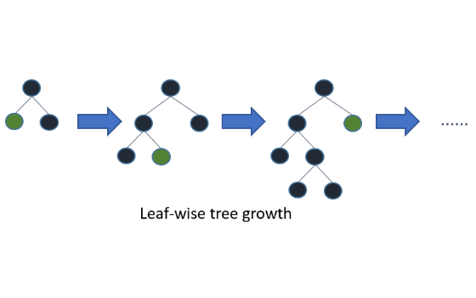
Model Mechanic: LightGBM
Leaf-wise Decision Trees
•
Leaf-wise Growth: Splitting based on max loss reduction; superior for Walmart's scale.
•
Regression Objective: Optimized using Mean Squared Error (MSE) for the target sales column.
•
EFB: Exclusive Feature Bundling reduces the high-dimensional SKU categorical space.
•
Histogram Binning: Discretizes continuous prices to accelerate training.

Slide 10
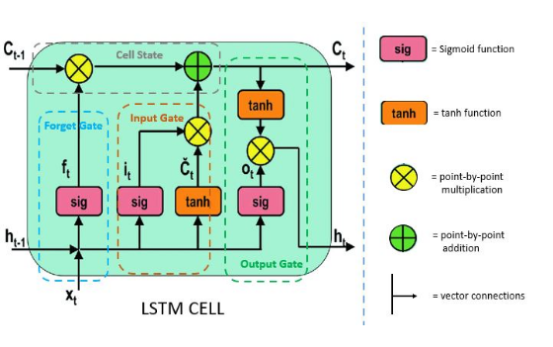
Model Mechanic: LSTM
Neural Sequence Modeling
•
Gating Logic: Uses Forget, Input, and Output gates to maintain long-term memory.
•
Global Approach: A single network learns shared patterns across all 30k products.
•
Embeddings: Learns high-dimensional representations of Store and Item IDs.

Slide 11






Forecasting Paradigms
Classical
Machine Learning
Deep Learning
ARIMA, Holt-Winters, and Smoothing. Robust for stable cycles but limited by univariate history.
LightGBM and XGBoost. Superior at mapping prices, SNAP events, and calendar covariates.
PyTorch LSTM and Transformers. High capacity for global patterns across millions of rows.

Slide 12

Methodology: Pilot Study Design
Pilot Focus: Store California 1 (CA_1)
Dataset Sample: 3,049 items with 5 years of daily history.
Logic: Algorithm selection through controlled benchmarking on high-variance retail environments.
Benchmarked 10 distinct algorithm configurations.
Aggregated results across all SKUs for statistically significant selection.

Slide 13
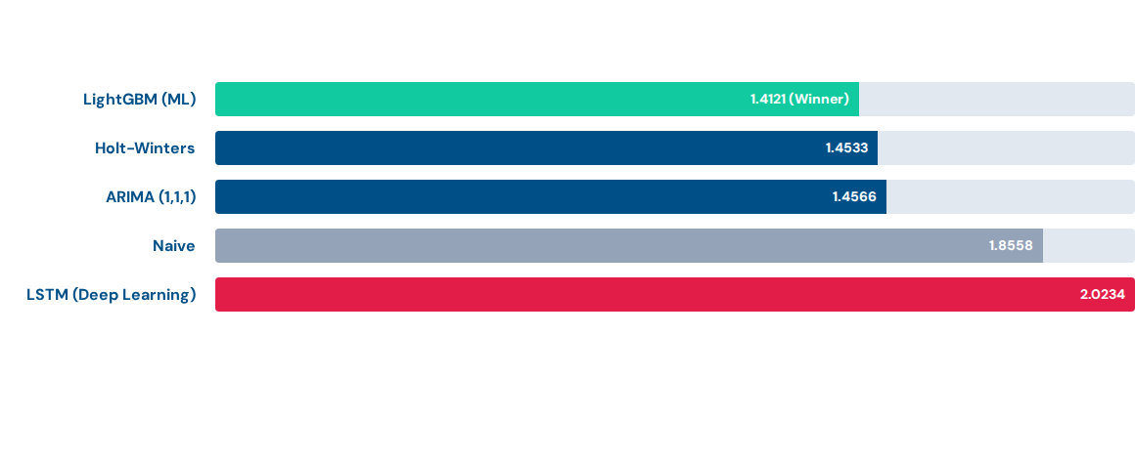
Forecast Accuracy Results (CA_1 Pilot)
Average RMSE across 3,049 items in Store CA_1. Lower is better.

Slide 14
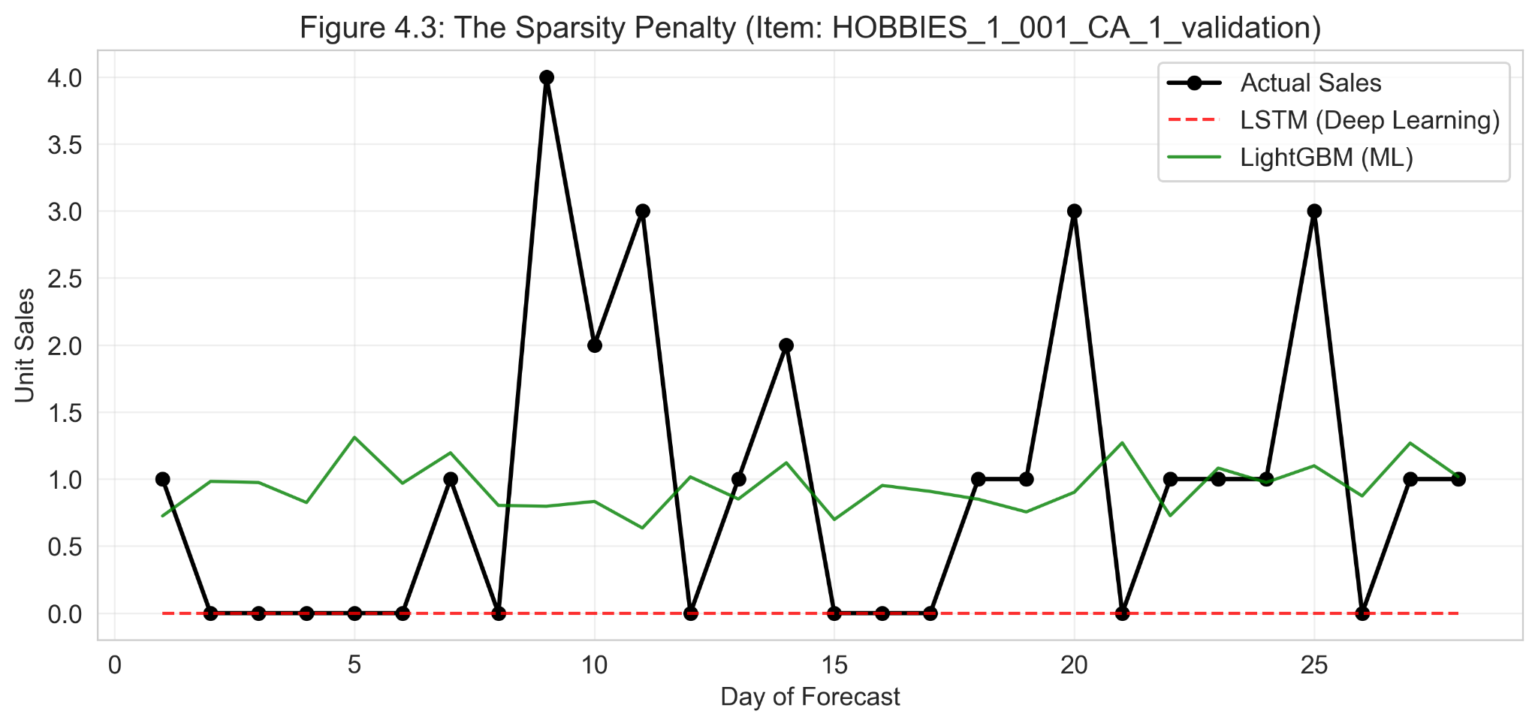
The "Sparsity Penalty"
Why LSTM Underperformed
On zero-sales days, LSTM predicts a "safe mean" (e.g., 0.3 units) instead of a true zero.
Operational Friction: Fractional forecasts trigger unnecessary reorders, exploding holding costs in sparse retail environments.
LightGBM's tree-splits handled zero-inflation significantly better.

Slide 15

Inventory Optimization Framework
Simulation Parameter | Value | Description
Target Service Level (α) | 95% | Probability of meeting demand during lead time.
Lead Time (L) | 7 Days | Assumption for replenishment cycle.
Holding Cost (H) | $1.00 / unit | Cost to store inventory per period.
Stockout Cost (P) | $10.00 / unit | Lost margin and penalty for unmet demand.

Slide 16
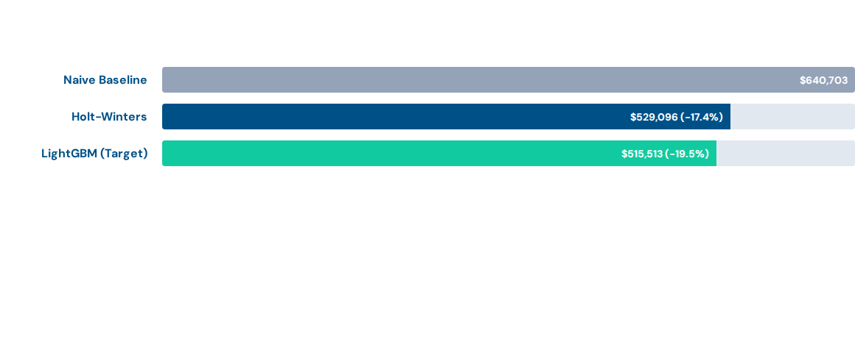

Financial Impact: Simulated Savings
Total Estimated Annual Savings: $125,190
Achieved through 19.5% Logistics Cost reduction via ML-driven accuracy.

Slide 17
Managerial Recommendations
Algorithm Choice: Use LightGBM/GBDT for sparse retail SKUs; LSTM requires significant "zero-handling" tuning to be viable.
Tooling ROI: Polars is essential for IE systems involving big data (50M+ rows) to avoid hardware bottlenecks.
Decision Support: IE focus should shift from minimizing RMSE to minimizing Total Logistics Cost to align with business KPIs.

Slide 18
Sustainability & ESG Impact
-19.5%
Waste Reduction
Emissions
Lower Warehouse Energy Footprint (HVAC/Lighting) via reduced inventory levels.
Higher accuracy in FOODS reduces spoilage and physical waste of expired items.
Minimizing "Rush Shipments" allows for high-efficiency scheduled logistics routing.a

Slide 19
Roadmap to IE 4198
Inventory Simulation: Run inventory simulation and optimize the results
Recursive Inference: Developing Day-by-Day lag updates to prevent data leakage in 28-day horizons.
Global Scaling: Training the LightGBM champion on all 10 Walmart stores (30,490 SKUs).
Horizontal Scaling: Training other complex algorithms like DeepAR to test it against others.
Dashboard Deployment: Finalizing the Next.js DSS for real-time inventory sensitivity analysis.

Slide 20





Image Sources
https://www.crwflags.com/fotw/images/t/tr_marm2.gif
Source: www.crwflags.com
https://gosmartlog.com/wp-content/uploads/2017/04/bullwhip-effect.jpg
Source: gosmartlog.com
https://careers.dwp.gov.uk/wp-content/uploads/2022/01/Banner-data-engineer-1.jpg?x67701
Source: careers.dwp.gov.uk
https://lightgbm.readthedocs.io/en/latest/_images/leaf-wise.png
Source: lightgbm.readthedocs.io
https://pluralsight2.imgix.net/guides/8a8ac7c1-8bac-4e89-ace8-9e28813ab635_3.JPG
Source: www.pluralsight.com

Slide 21
References
Hochreiter, S., & Schmidhuber, J. (1997). Long short-term memory. Neural computation, 9(8), 1735-1780.
Makridakis, S., Spiliotis, E., & Assimakopoulos, V. (2018). Statistical and Machine Learning forecasting methods: Concerns and ways forward. PloS one, 13(3), e0194889.
Makridakis, S., Spiliotis, E., & Assimakopoulos, V. (2022). M5 accuracy competition: Results, findings, and conclusions. International journal of forecasting, 38(4), 1346-1364.
Ashish, V. (2017). Attention is all you need. Advances in neural information processing systems, 30, I.
Syntetos, A. A., Boylan, J. E., & Disney, S. M. (2009). Forecasting for inventory planning: a 50-year review. Journal of the Operational Research Society, 60(sup1), S149-S160.
Lee, H. L., Padmanabhan, V., & Whang, S. (1997). The bullwhip effect in supply chains.
Ke, G., Meng, Q., Finley, T., Wang, T., Chen, W., Ma, W., ... & Liu, T. Y. (2017). Lightgbm: A highly efficient gradient boosting decision tree. Advances in neural information processing systems, 30.
Theodorou, E., Wang, S., Kang, Y., Spiliotis, E., Makridakis, S., & Assimakopoulos, V. (2022). Exploring the representativeness of the M5 competition data. International Journal of Forecasting, 38(4), 1500-1506.
Benidis, K., Rangapuram, S. S., Flunkert, V., Wang, Y., Maddix, D., Turkmen, C., ... & Januschowski, T. (2022). Deep learning for time series forecasting: Tutorial and literature survey. ACM Computing Surveys, 55(6), 1-36.

Slide 22
Questions?
A Comparative Analysis of Classical and Deep Learning Forecasting
for Supply Chain Inventory Optimization
Hakan İspir • Boran Turan • Deniz Yağmur Adaş • Ali Kahya
Marmara University | Industrial Engineering Department

